Slide 1

Meetup x Penpal
By Baiq Nurul Haqiqi, Nicole Shek, Sara Yassine, Jiuming Qin, Chloe Yeo
PenPal x Meetup

Slide 2
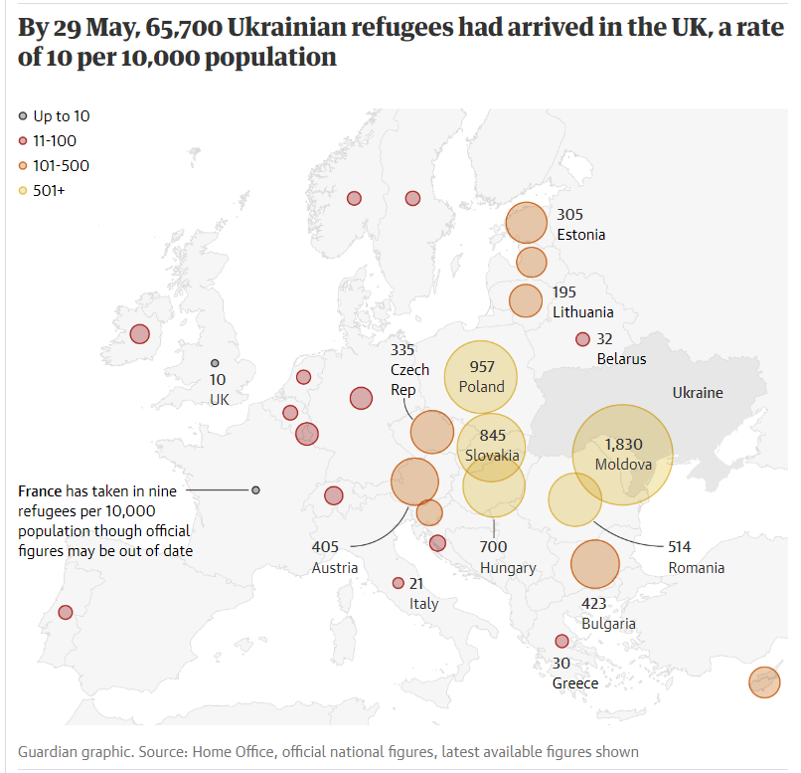

Did you know?
Did you know?
Notes:
Source: https://www.theguardian.com/uk-news/2022/jun/03/uk-takes-in-fewer-ukrainians-per-capita-than-most-of-europe

Slide 3
Did you know?
Did you know?
Research indicates that the various stressors refugee children experience before, during and after displacement are associated with various types of mental health problems.
25% of refugee children suffer from loneliness
24% of refugee children report feeling depressed
Notes:
Source: https://www.theguardian.com/uk-news/2022/jun/03/uk-takes-in-fewer-ukrainians-per-capita-than-most-of-europe

Slide 4
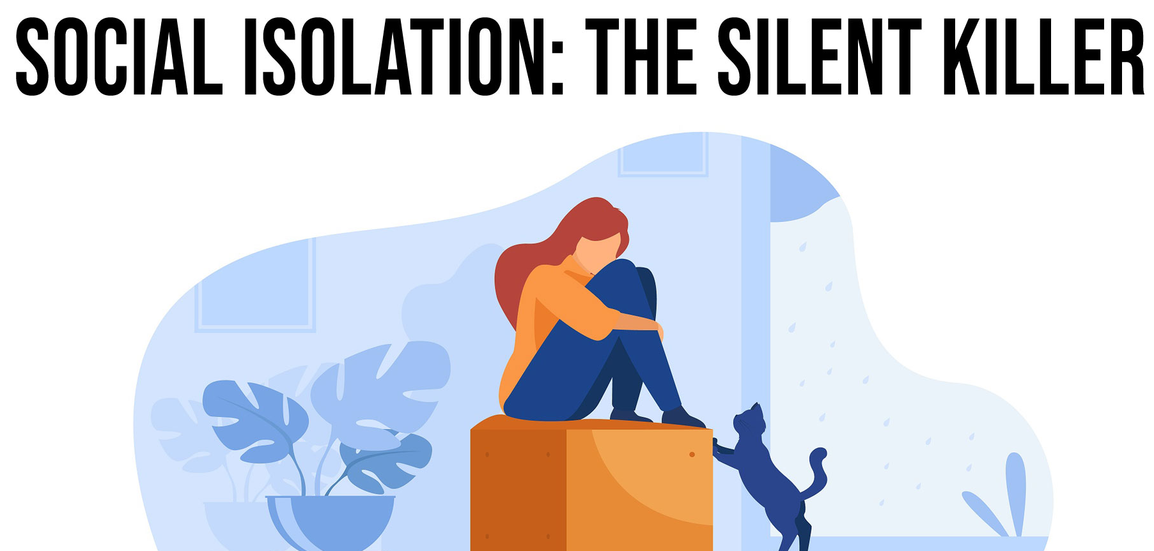
Even more facts…
They are also at higher risk of:
a weaker immune system
high blood pressure
cognitive decline
…and even death
Academic problems (53.6%)
Behavioural difficulties (44.6%)
Attachment problems (38.89%)

Slide 5

Problem statement
Children experiencing loneliness when arriving to a new country as a refugee is a common occurrence. They are separated from their friends back home and struggle to relate to their new friends. They need a way to connect with other children in the same situation as them.

Slide 6
UX/UI journey
Research
Ideation
Wireframing
Business research
User research
Low, mid and high fidelity

Slide 7

UX/UI journey
Iterate
Prototype

Slide 8

User research
“We moved to the UK to be together, but our family was ripped apart – I’ve never felt more lonely” Enioluwada, Age 17
“The most difficult thing is to communicate with other people because of the language barrier” Polina, Age 15
Notes:
https://www.bbc.co.uk/newsround/61156129#:~:text=It%27s%20thought%20that%20more%20than,at%20the%20end%20of%20February

Slide 9

Our solution
A cross between Penpal and Meetup for parents/guardians of Ukrainian children in the UK.

Slide 10

Our solution
Druh helps to…
Build meaningful connections for young Ukrainians (from children to teenagers) in the UK
Encourage Ukrainian parents to connect
Provide companionship and comfort via a penpal service
Encourage Ukrainian families in the same area to meet up

Slide 11
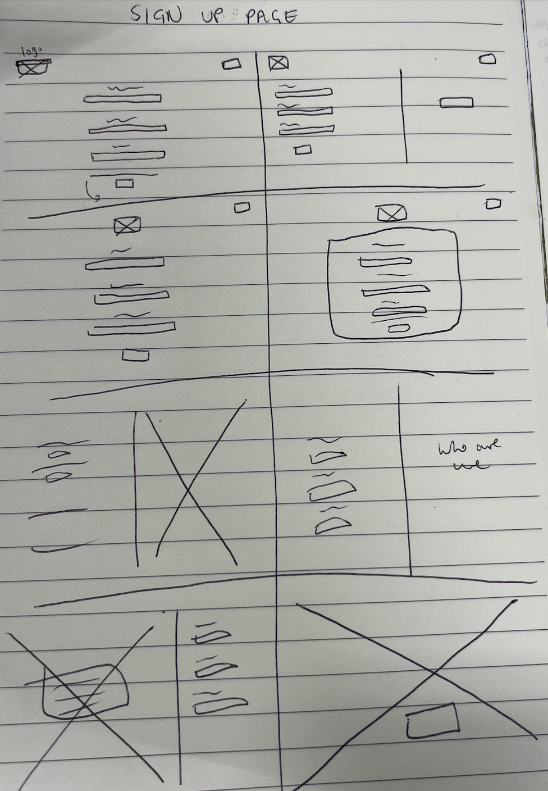

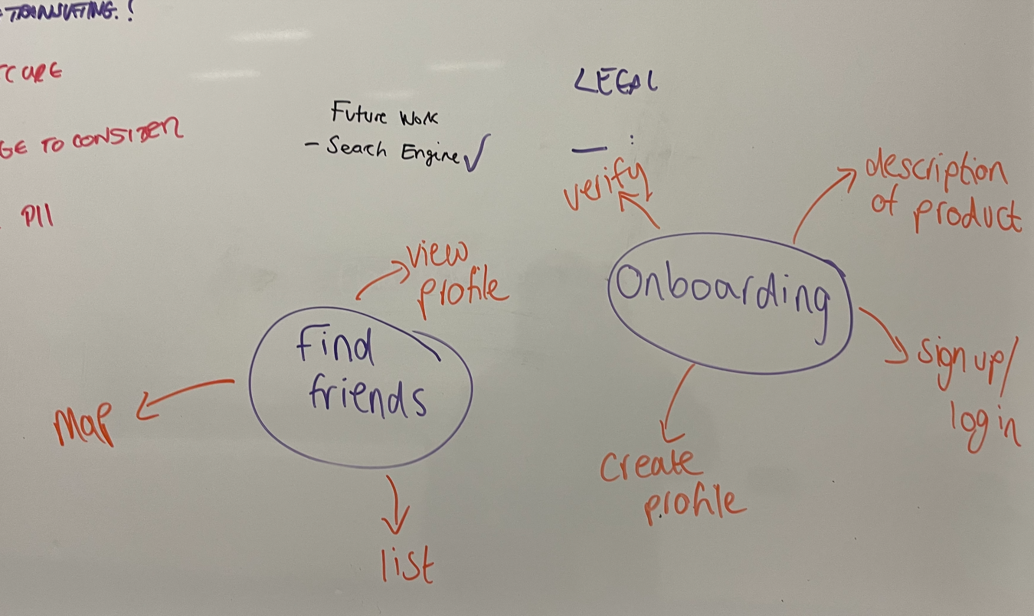
Ideation

Slide 12

Figma prototype

Slide 13
Website runthrough

Slide 14


Web technology
Frontend = React
Backend = Python Flask

Slide 15

Security
Website is for parents only - an error message will appear if a child tries to sign up
Two-step verification

Slide 16

Accessibility
Made sure to follow WCAG 2.1 guideline
Ensured there was enough contrast between the colours
Didn’t use colour as the only visual means of conveying information
Supported keyboard navigation
Ensured that it would work with screen readers e.g. all text is written out (not a screenshot)

Slide 17

What can we change in the future?
Speak to actual Ukrainian refugees!
Conduct more thorough research
Add:
Chat feature for parent/guardian users to communicate
A Google map to locate and show all users in the area
Settings…
Enhance security e.g. install SSL plugin
Make website responsive

